Slide 1
Validating Building Areas calculated by QGIS with that in google-maps

Slide 2
Example 1 8, Sophialaan, Abbenes QGIS area : 276 m2 Google Maps area: 223 m2

Slide 3
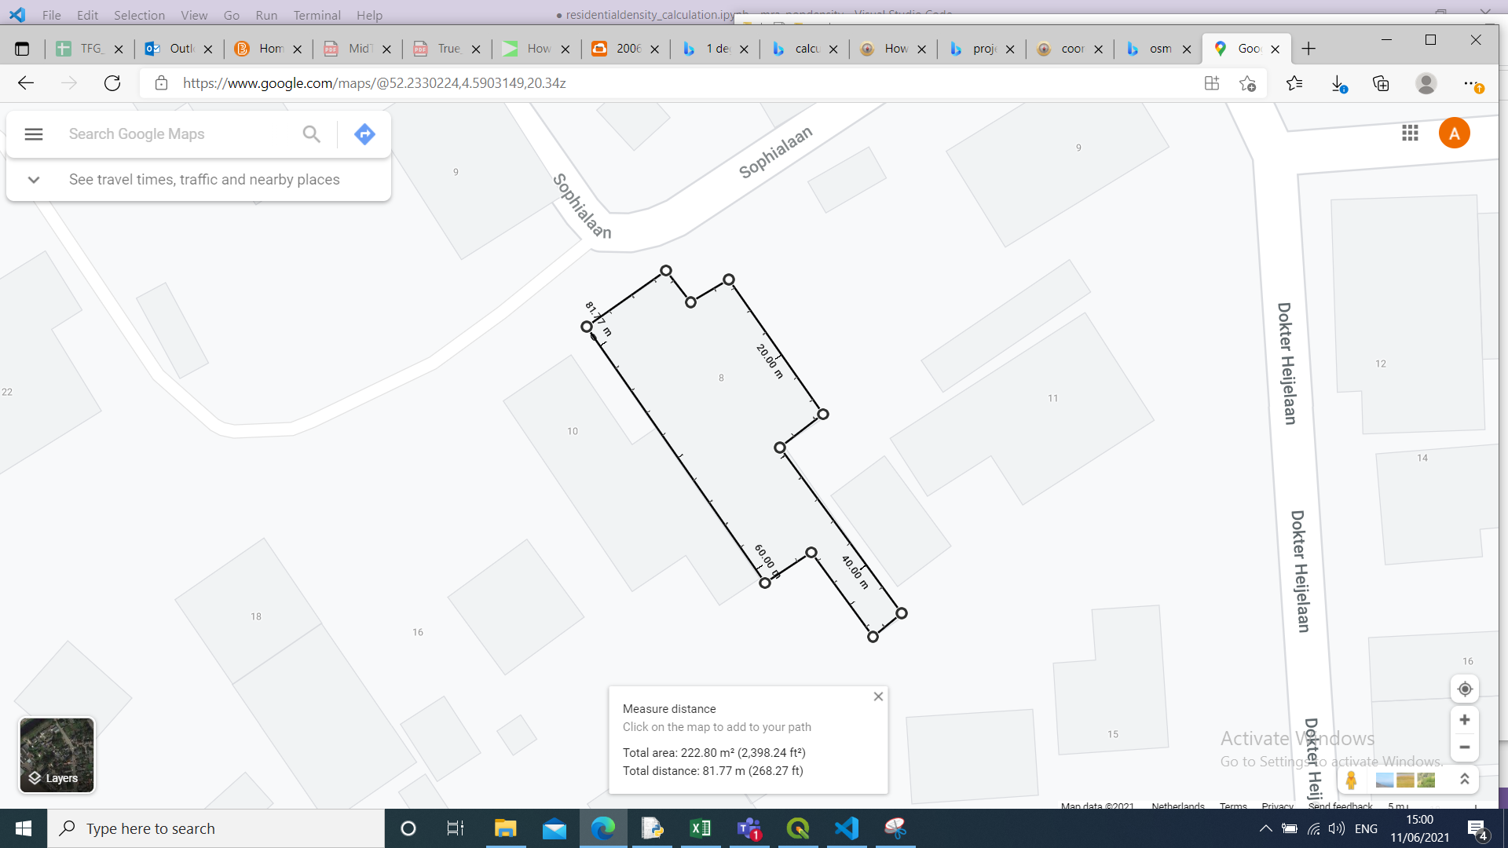

Slide 4
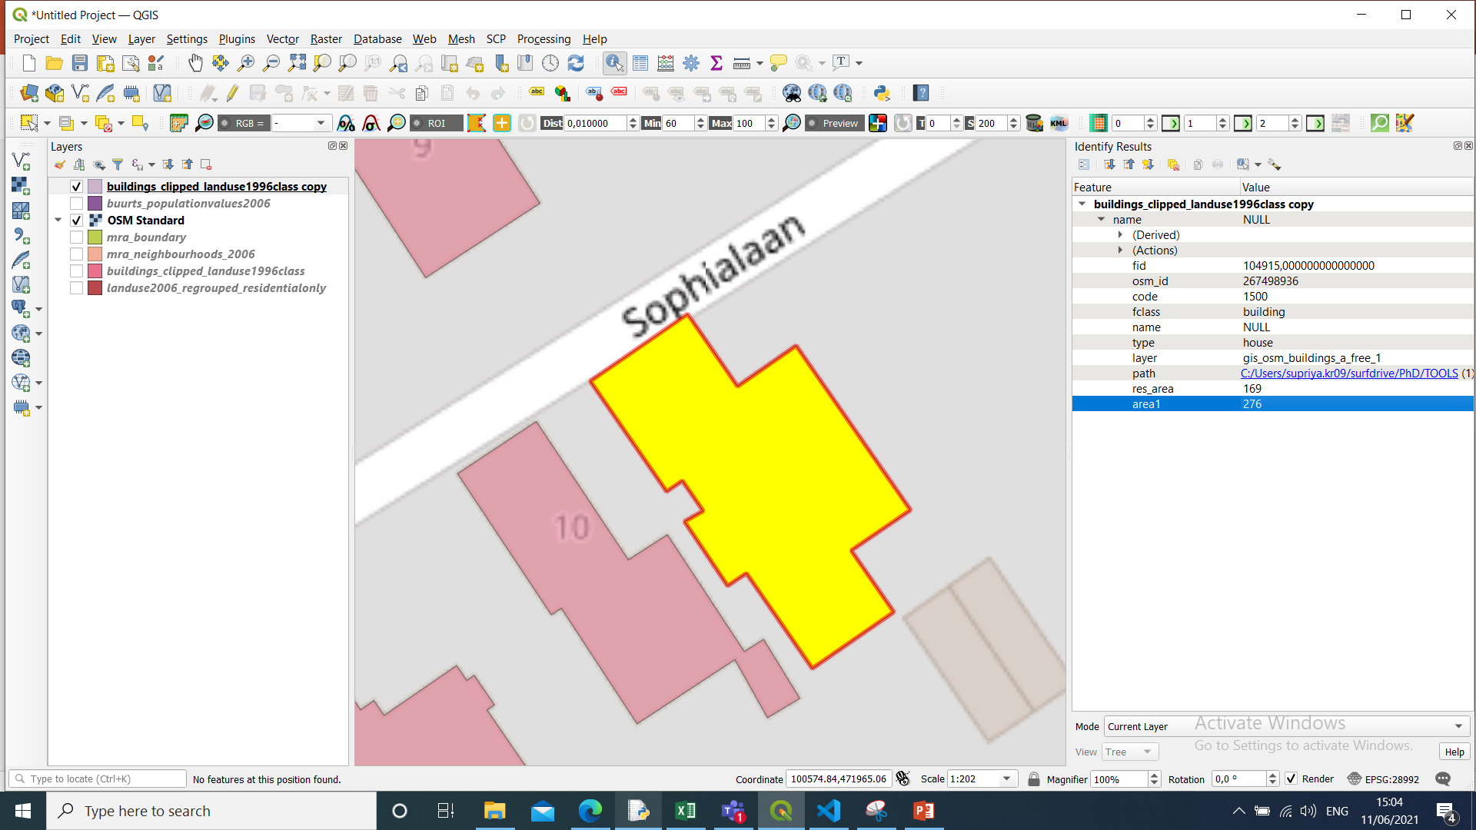

Slide 5
Example 2 24, Balthasar Florizstraat, Amsterdam QGIS Area : 101 m2 Google Maps: 69 m2

Slide 6
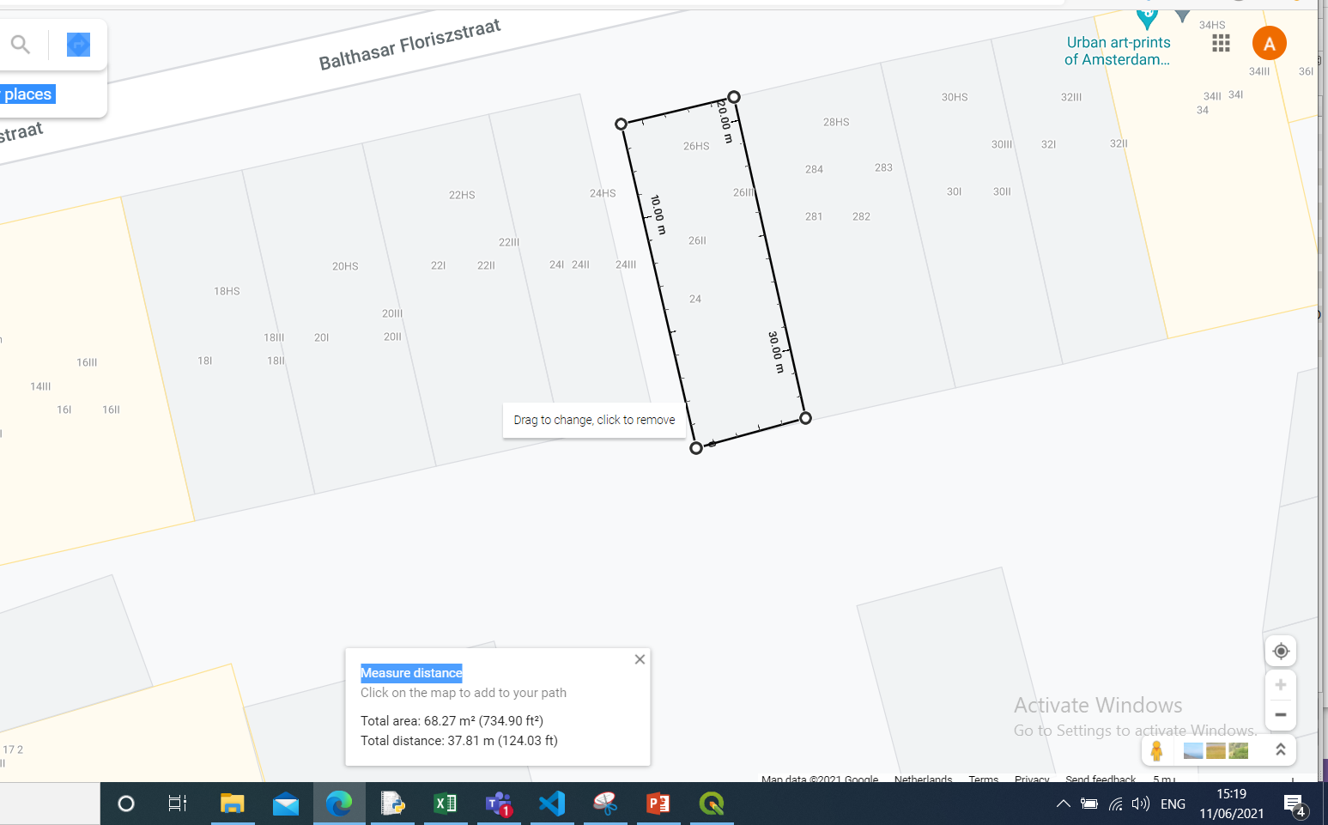

Slide 7
